Slide 1
DEVOPS PROJECT CS 4067
Submitted to:
Mr. Murtaza Fazal
Submitted by:
Insha Samnani (20K-0247)
Yusra Adam (20K-0207)
Ismail Ahmed Ansari (20K-0228)

Slide 2
Source Code Repository: GitHub (At least 2 different repos should be used)

Slide 3
GITHUB

Slide 4
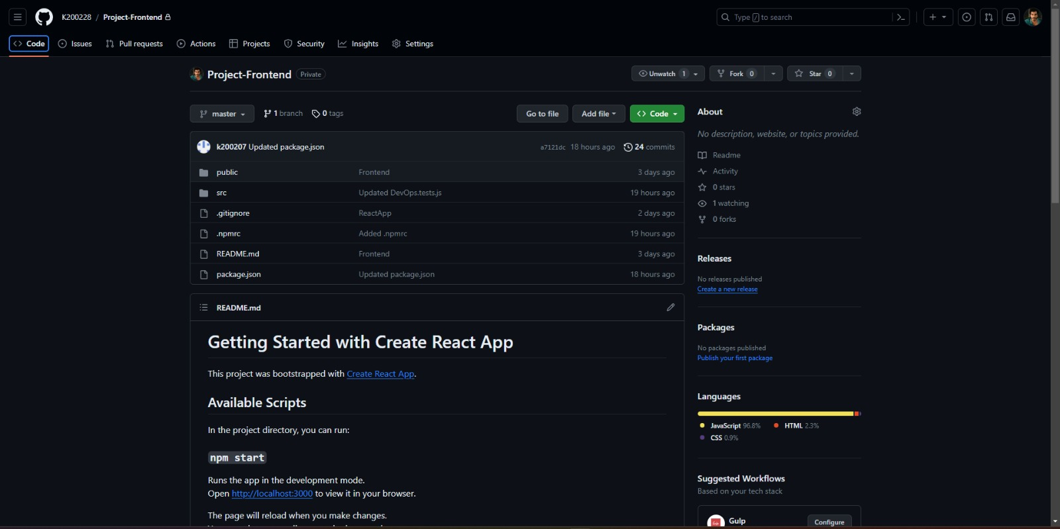
FRONTEND REPOSITORY

Slide 5
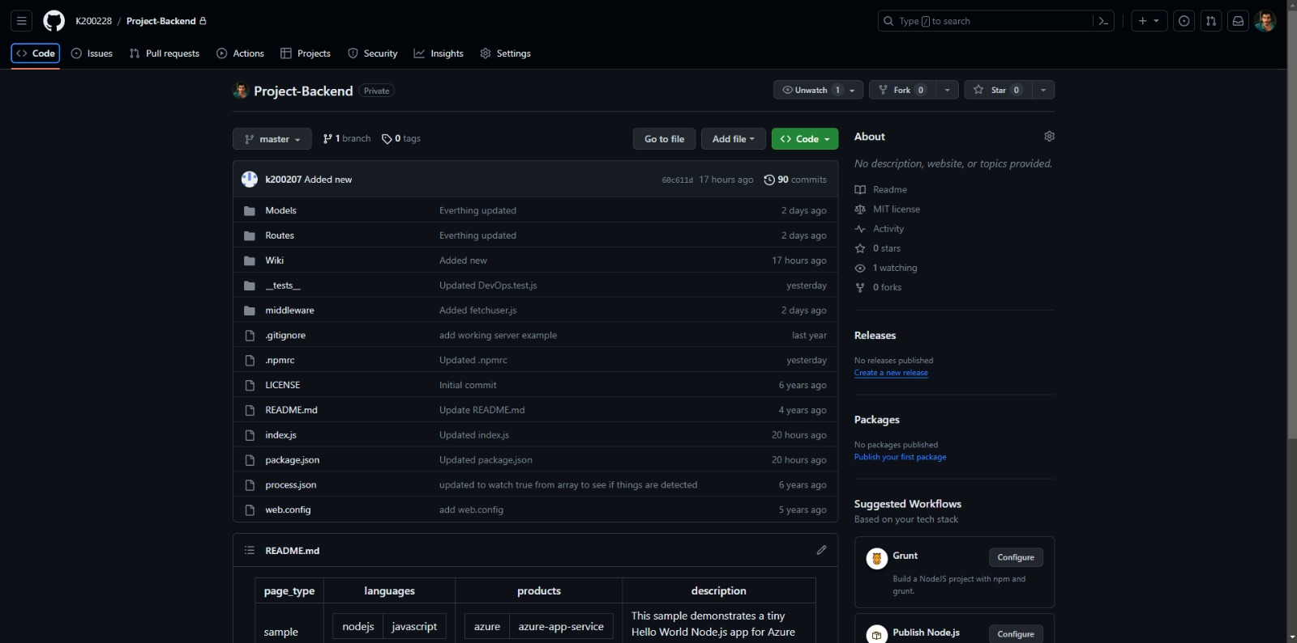
BACKEND REPOSITORY

Slide 6
AZURE DEVOPS

Slide 7
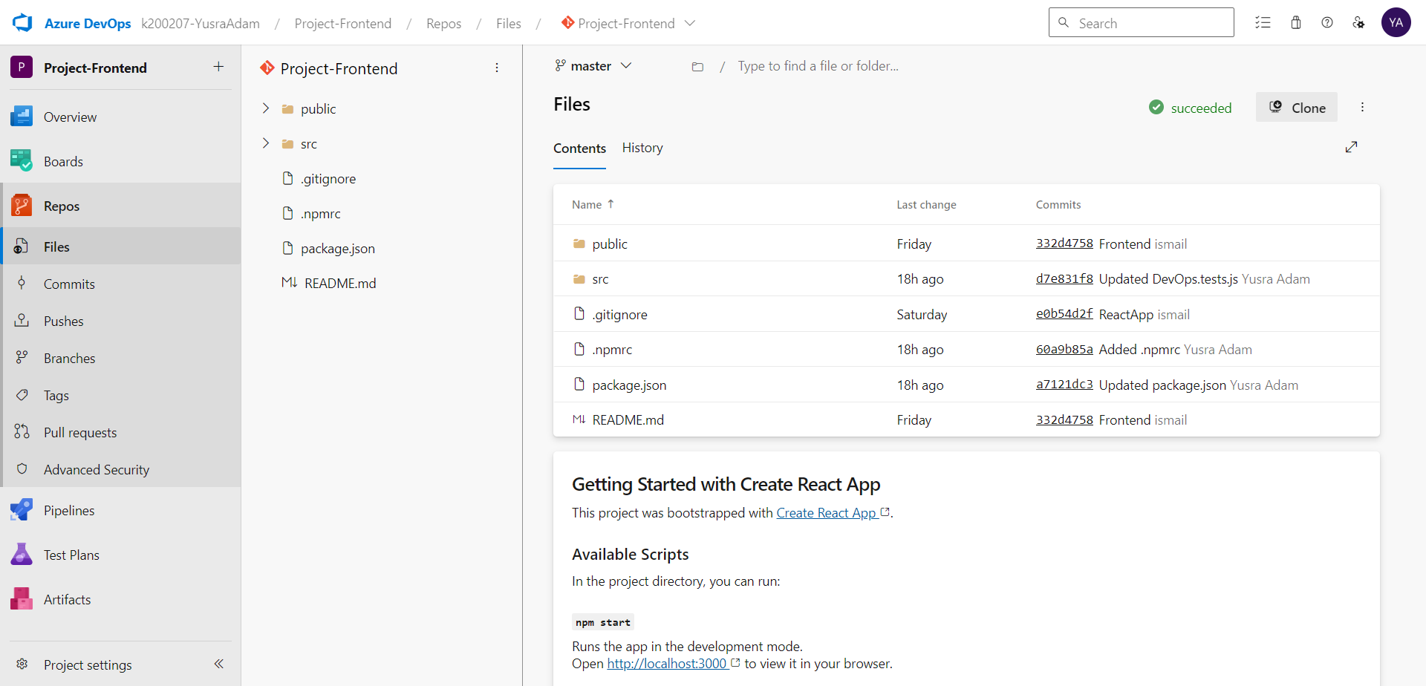
FRONTEND REPOSITORY

Slide 8
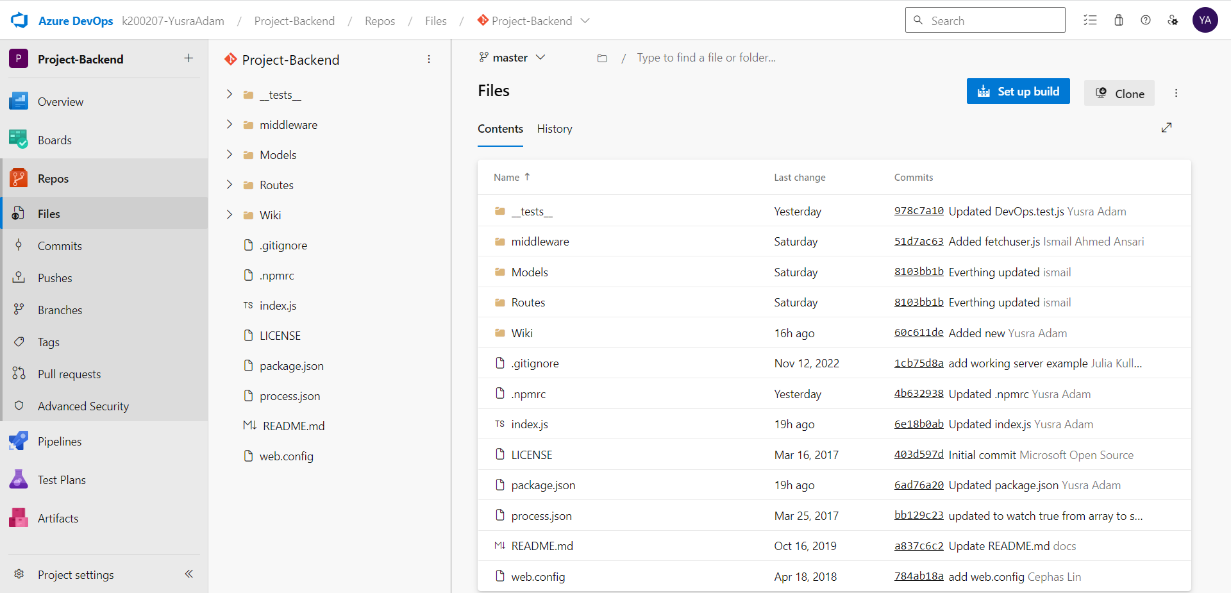
BACKEND REPOSITORY

Slide 9
Continuous Integration (CI Pipeline)

Slide 10
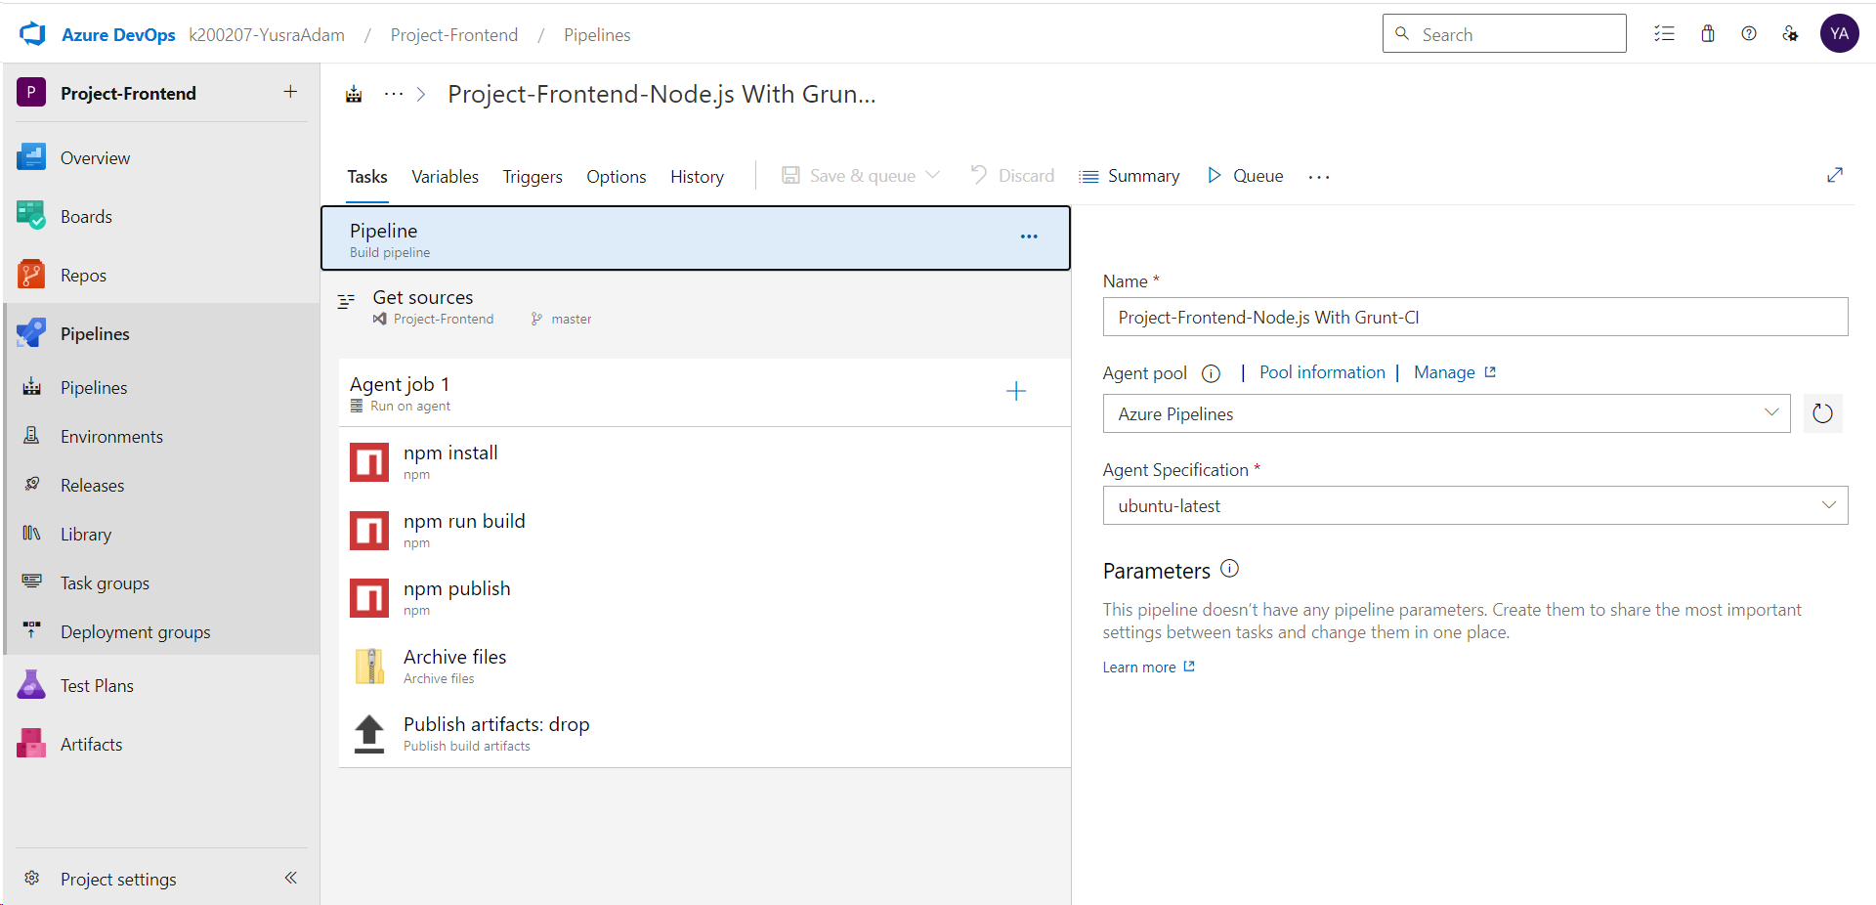
CI PIPELINE - FRONTEND

Slide 11
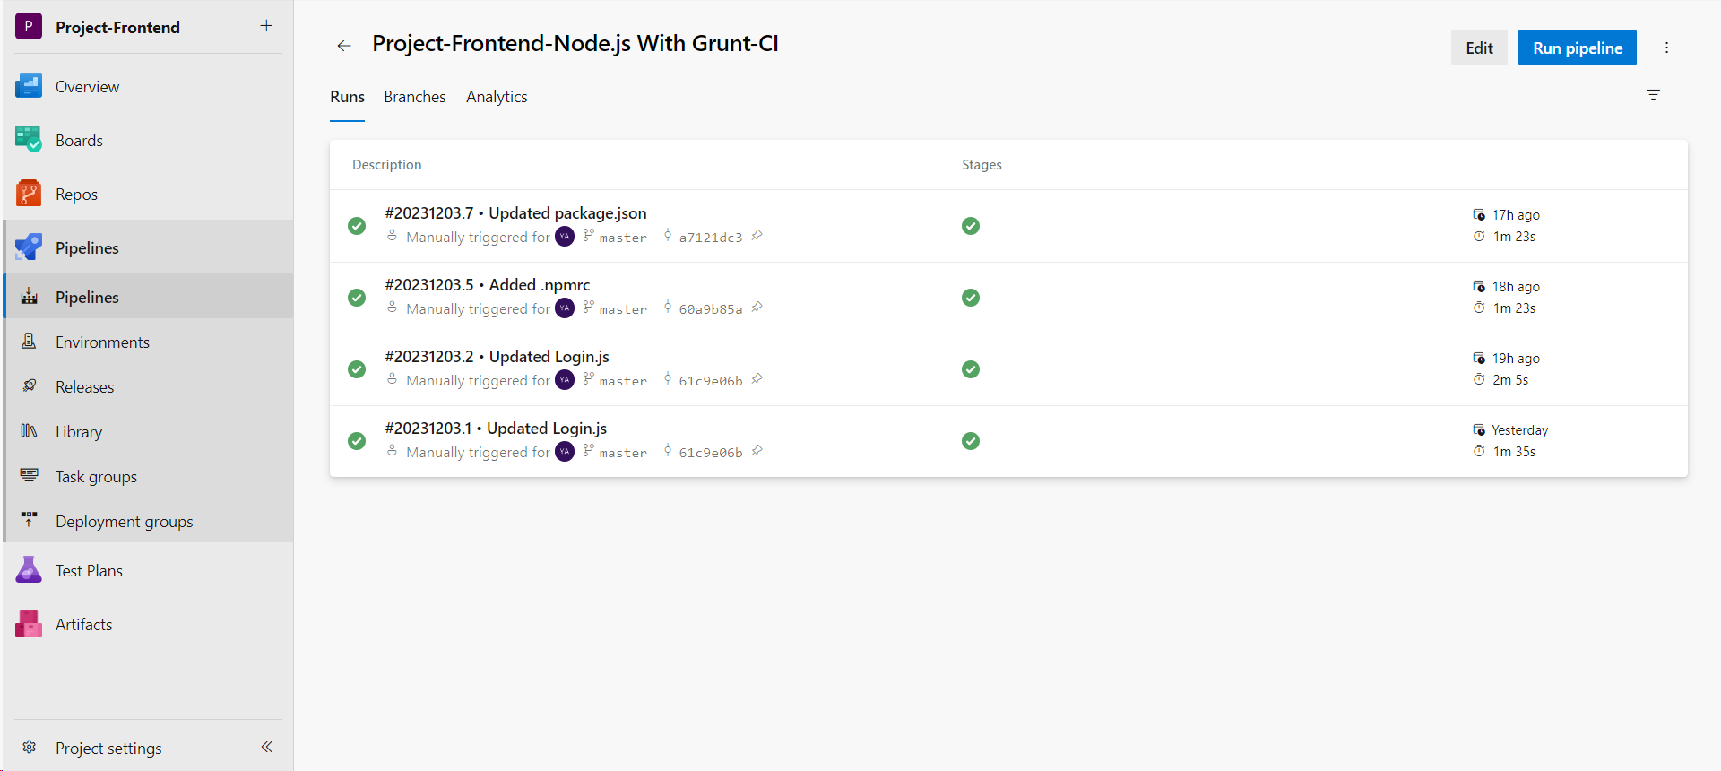

Slide 12
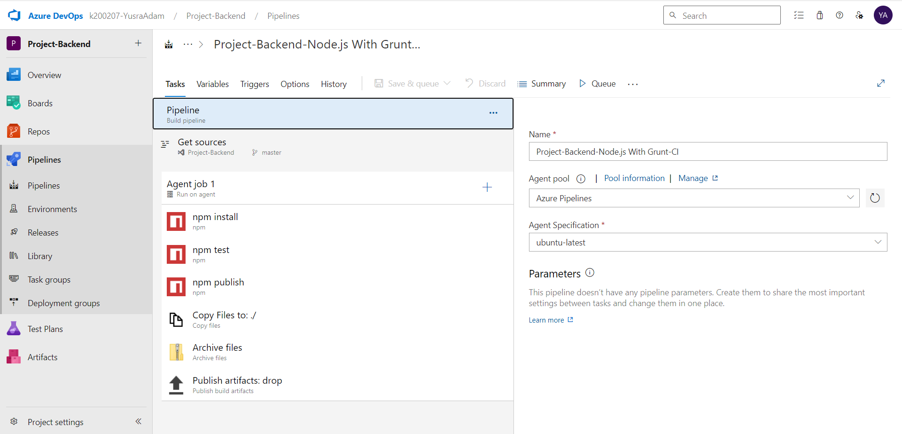
CI PIPELINE - BACKEND

Slide 13
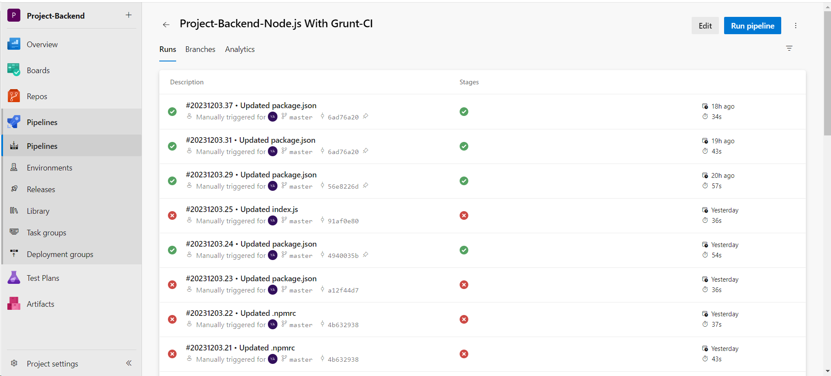

Slide 14
Unit Testing (At least 5 test cases)

Slide 15
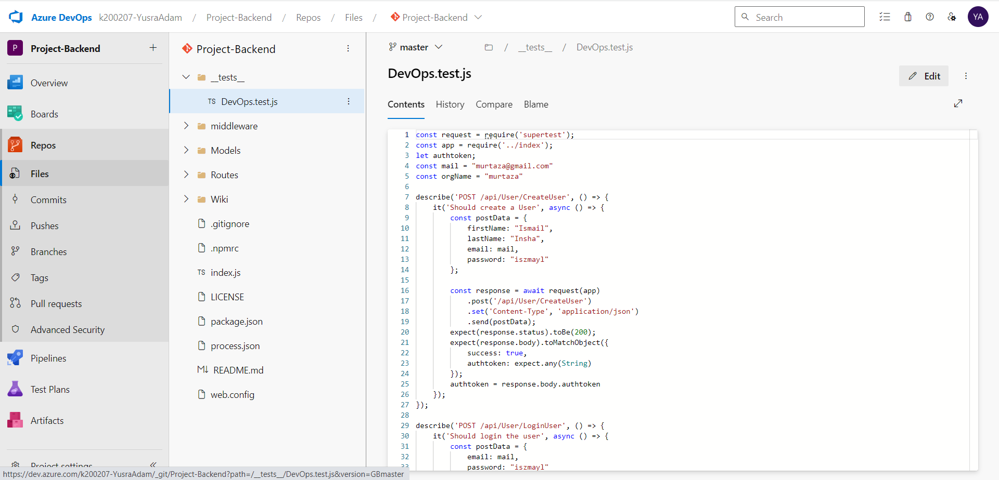

Slide 16
Automated Testing Scripts (Selenium)

Slide 17
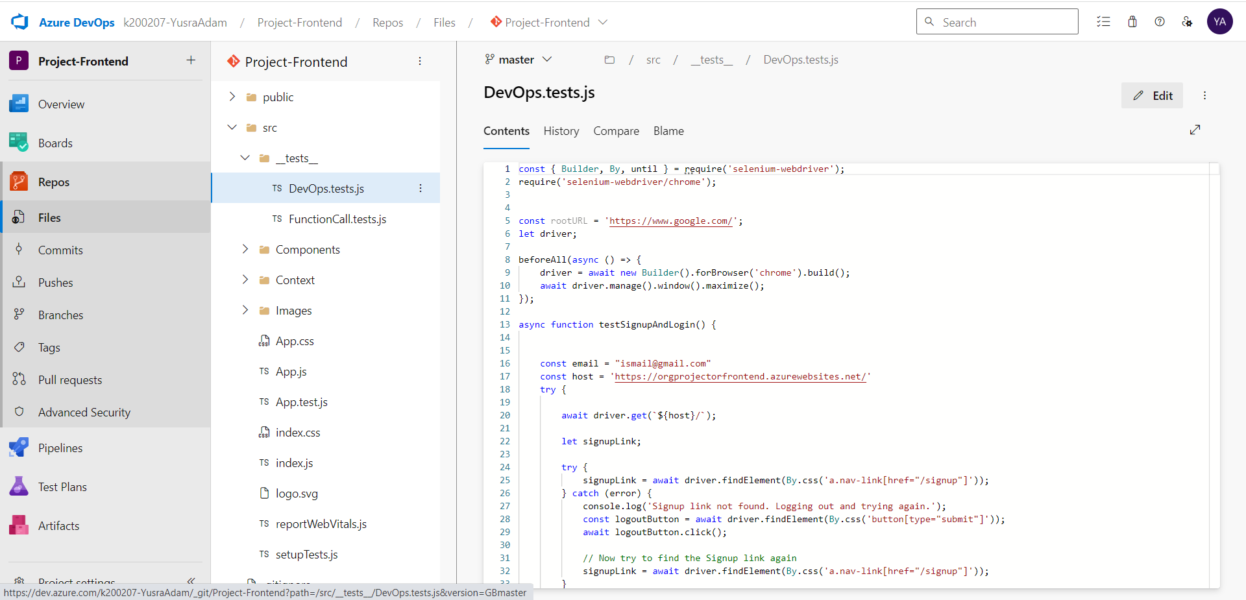

Slide 18
Continuous Deployment / Delivery (CD Pipeline - Release) Deployment Strategy: Deployment Rings (With Slow, Fast and Production Rings)

Slide 19
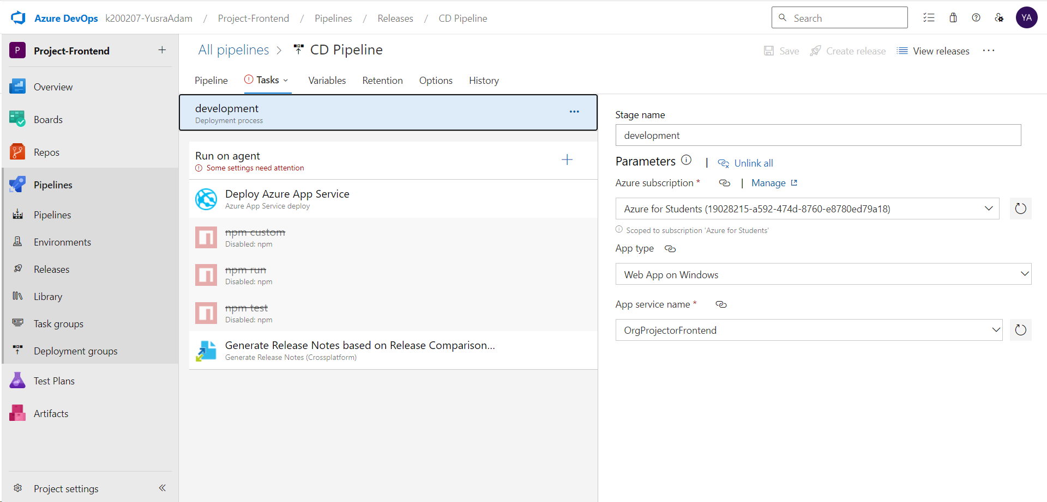
CD PIPELINE - FRONTEND

Slide 20
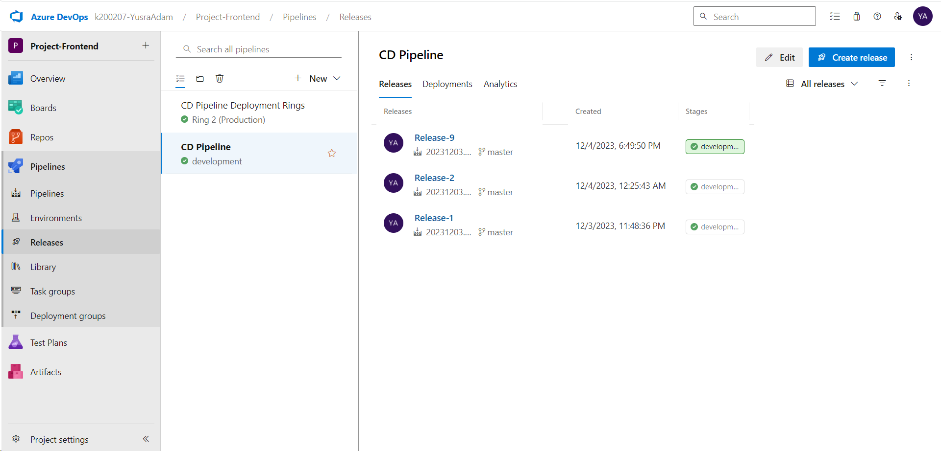

Slide 21
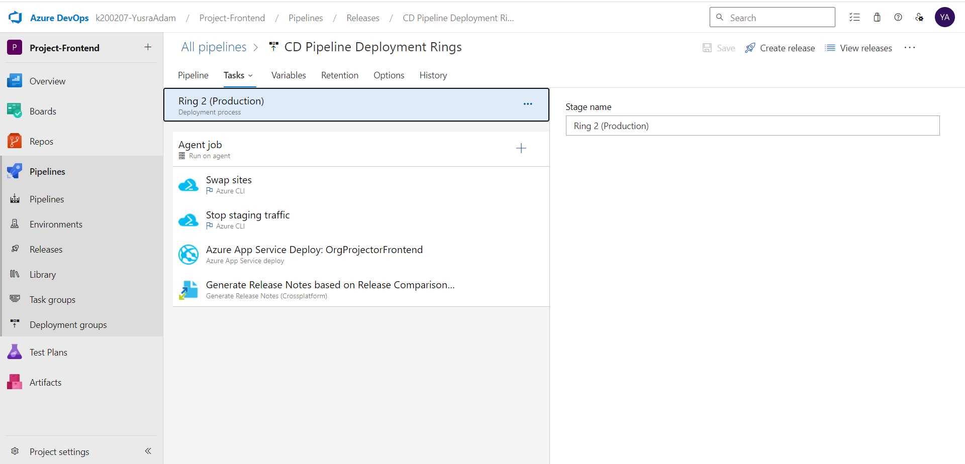
CD PIPELINE – FRONTEND (RING-BASED)

Slide 22
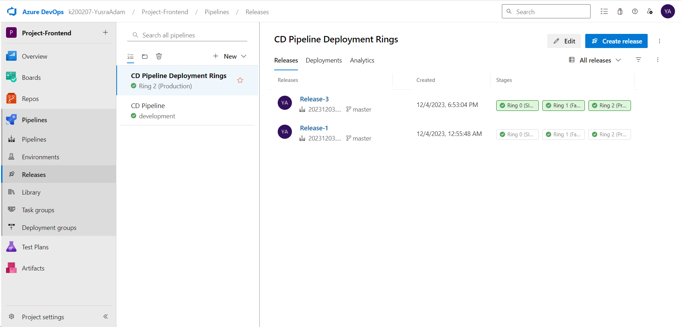

Slide 23
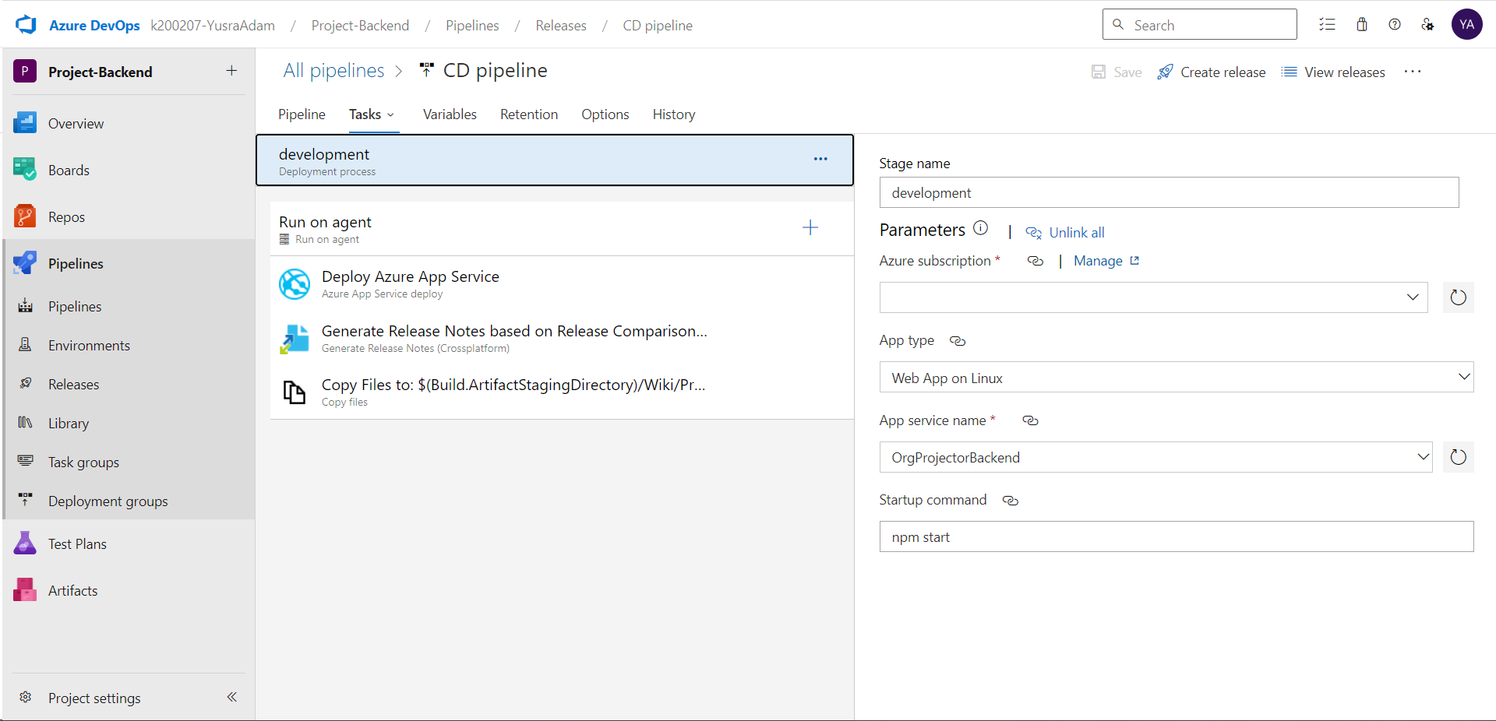
CD PIPELINE - BACKEND

Slide 24
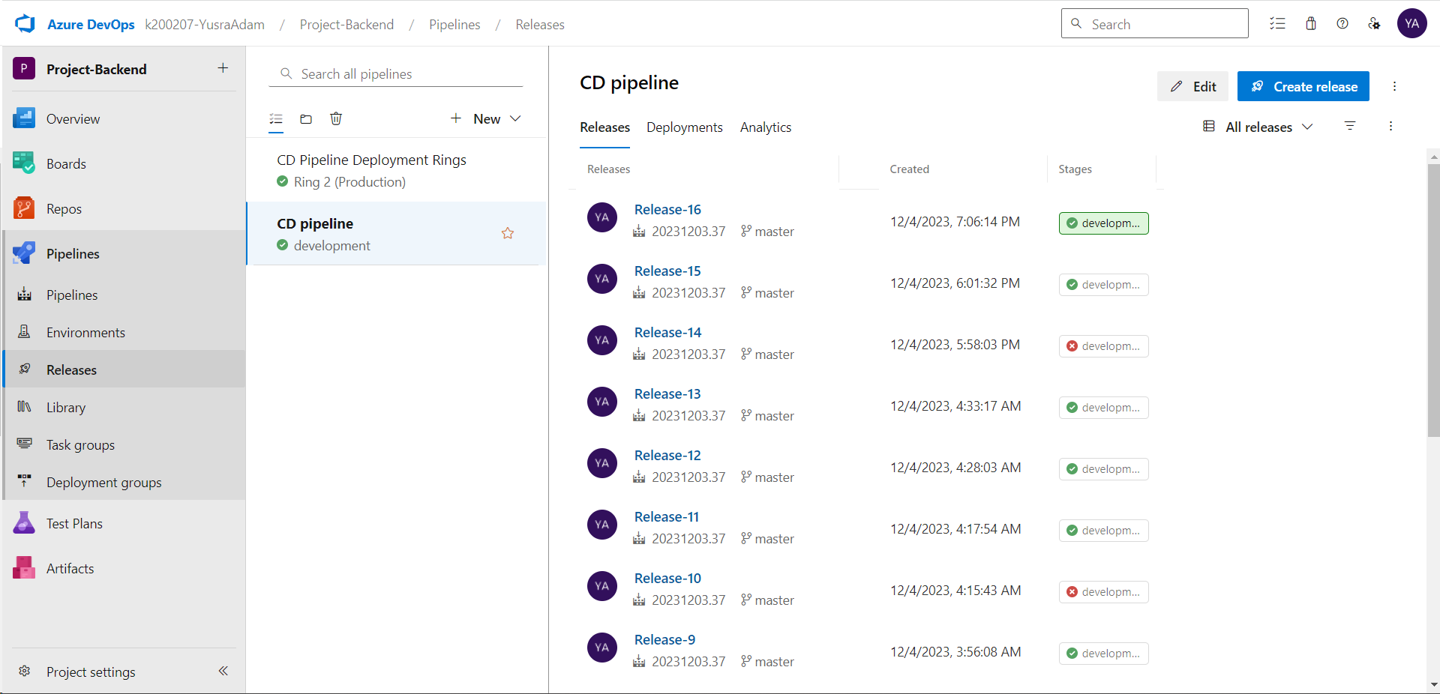

Slide 25
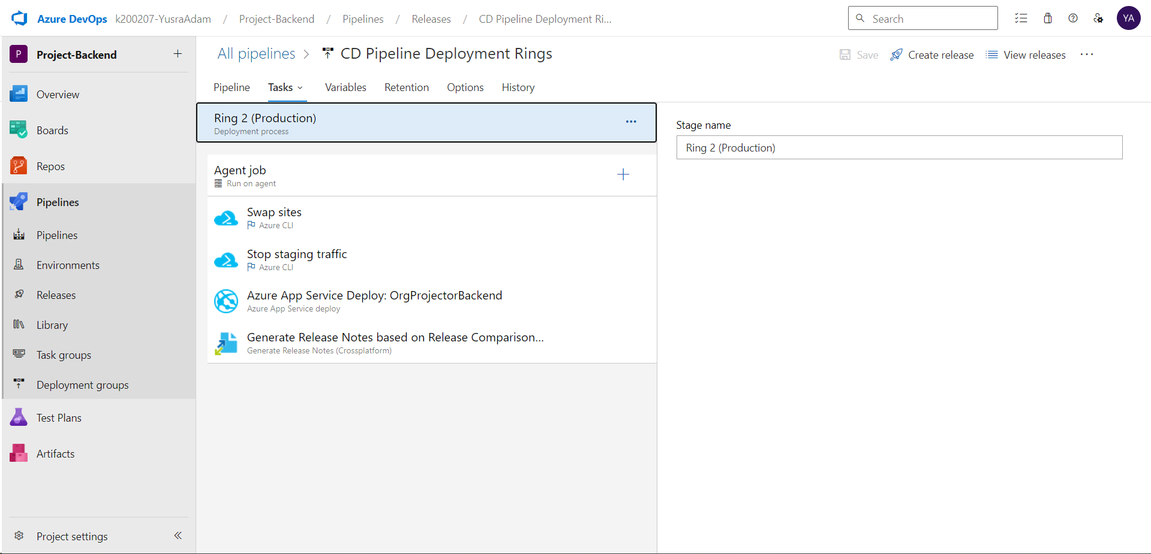
CD PIPELINE – BACKEND (RING-BASED)

Slide 26
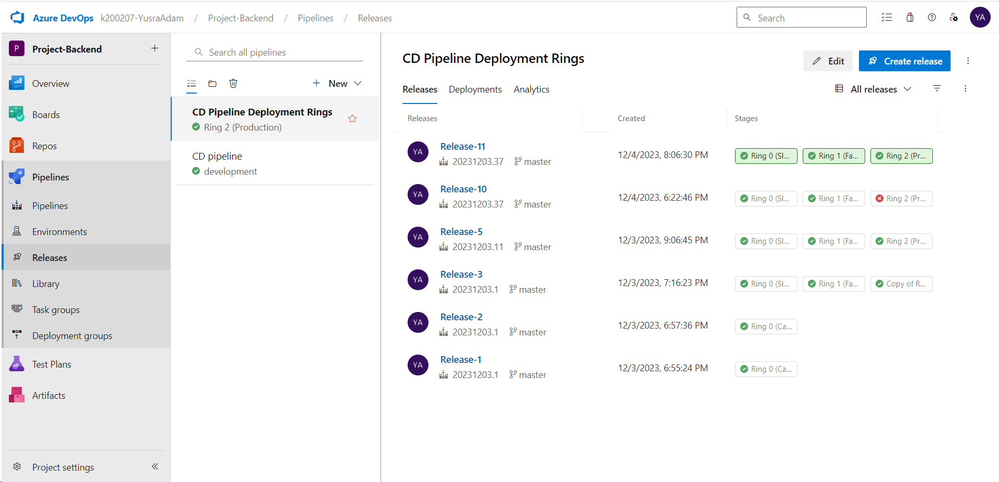

Slide 27
Release Gates

Slide 28
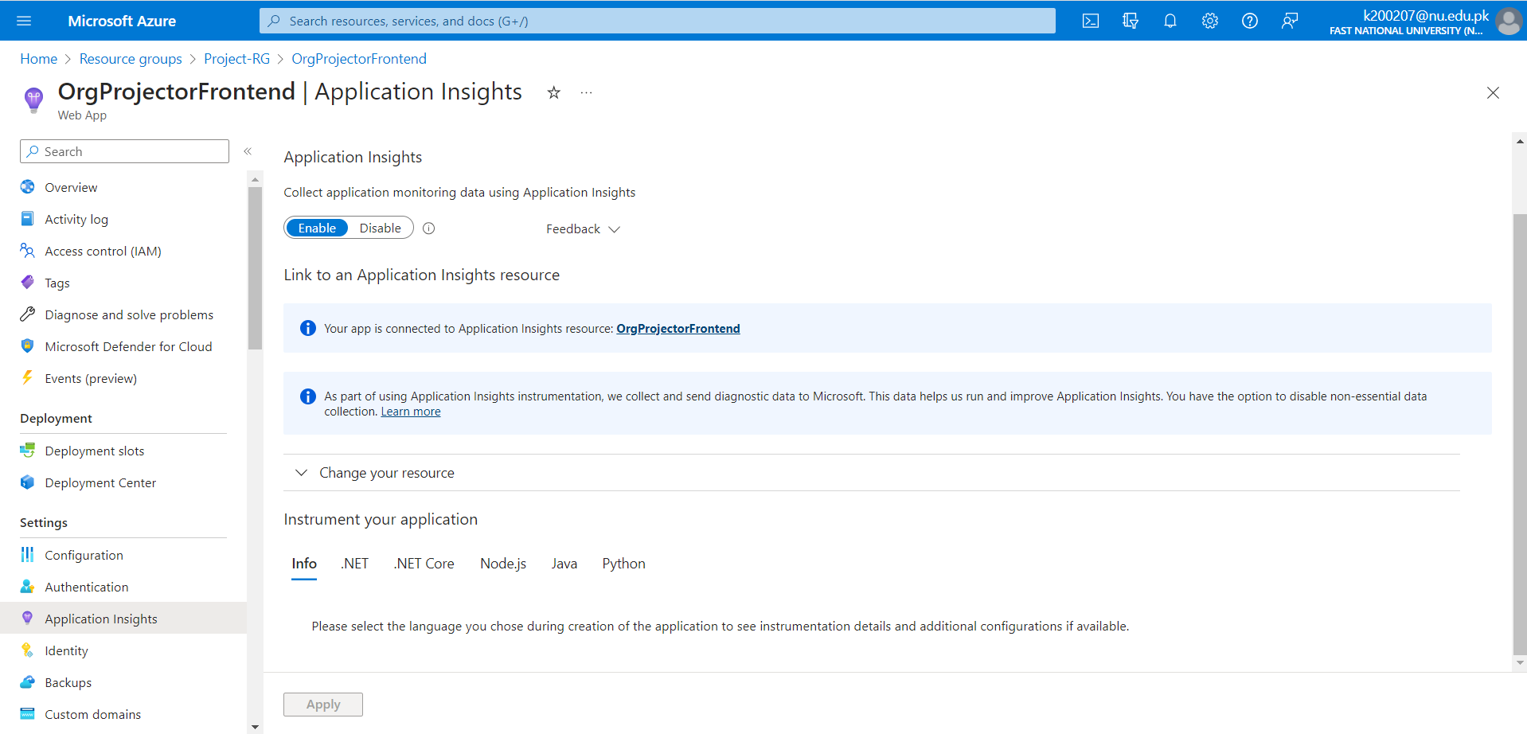
APPLICATION INSIGHTS - FRONTEND

Slide 29
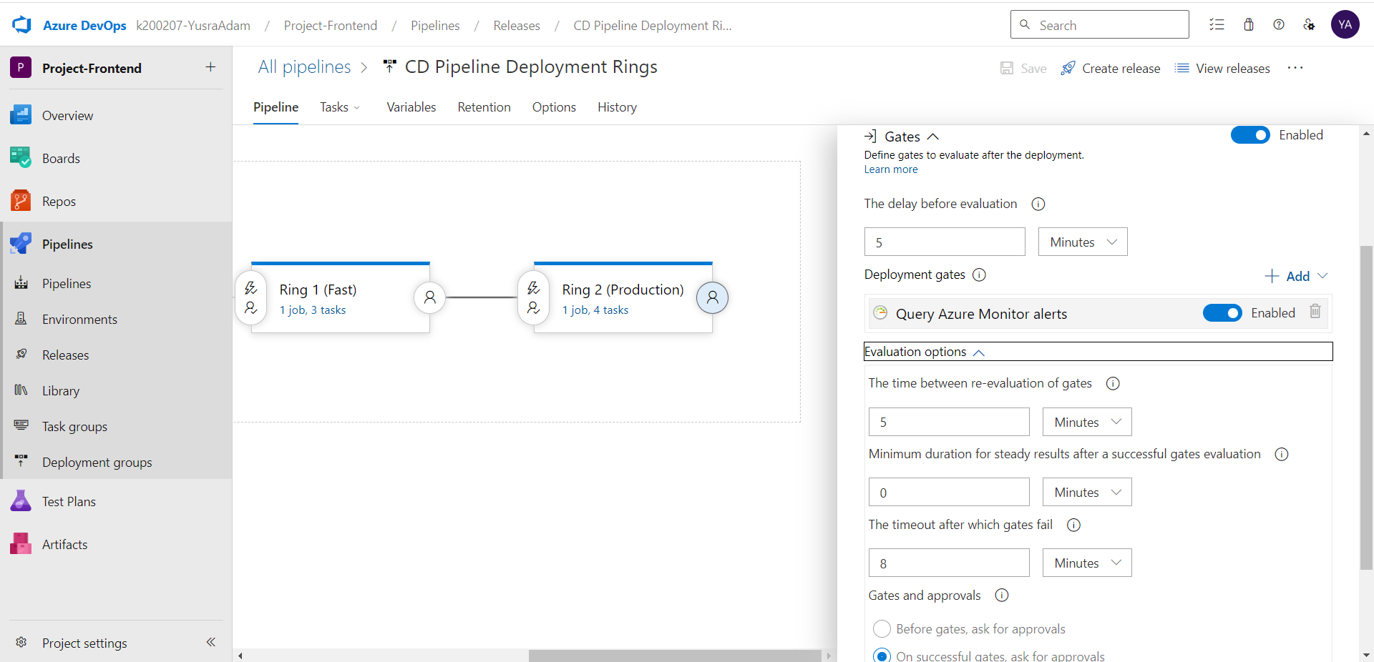
CD PIPELINE – FRONTEND (RING-BASED)

Slide 30
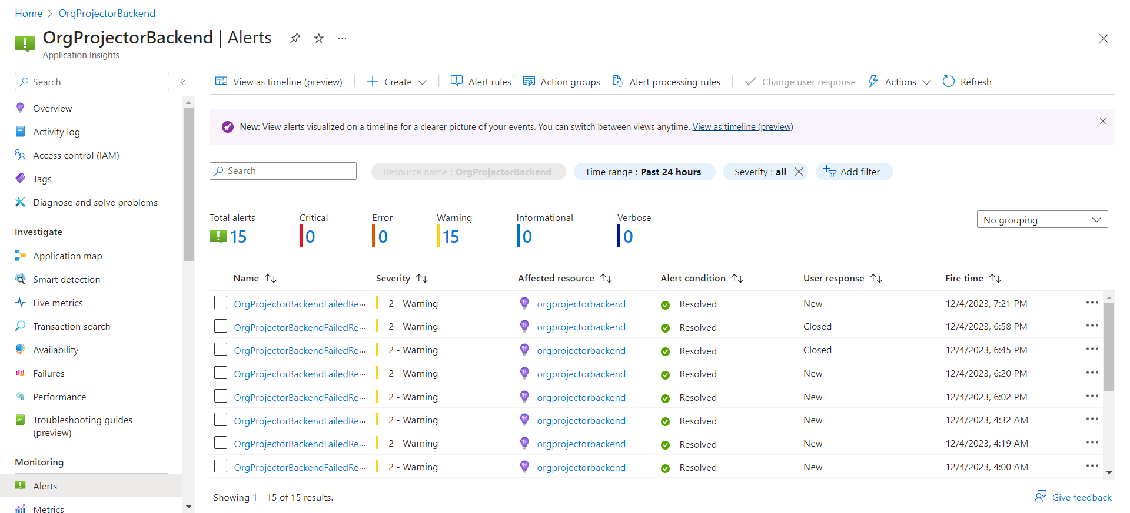
APPLICATION INSIGHTS - BACKEND

Slide 31
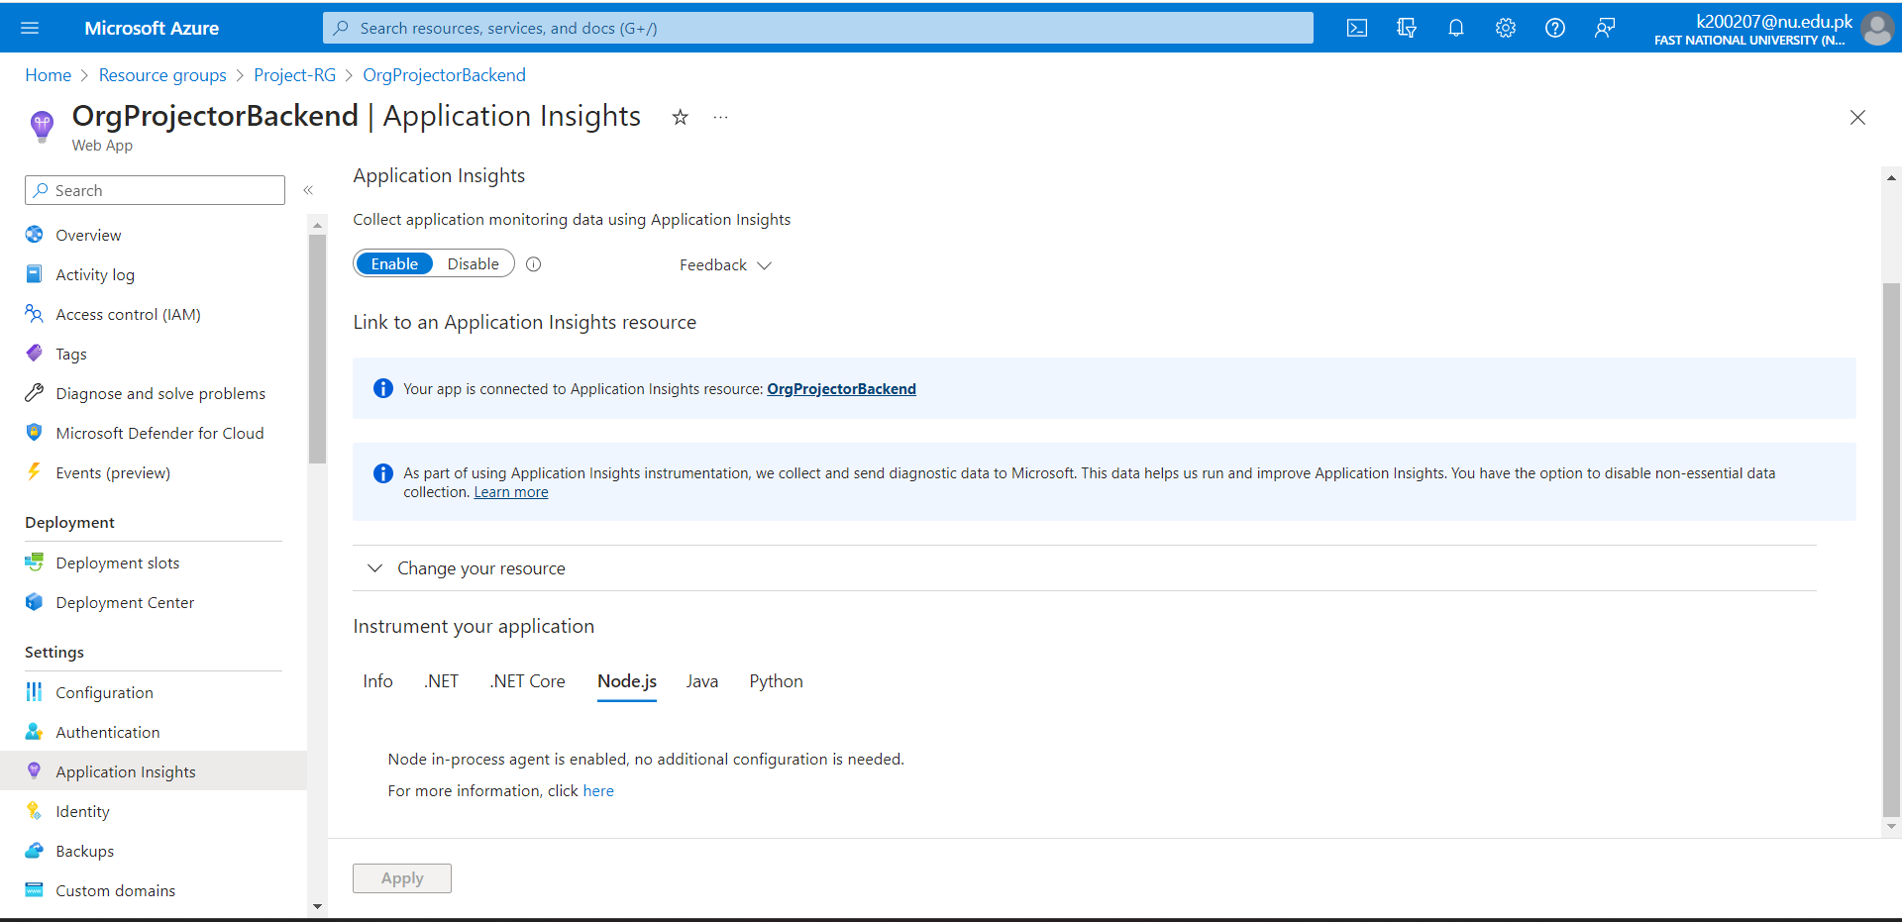

Slide 32
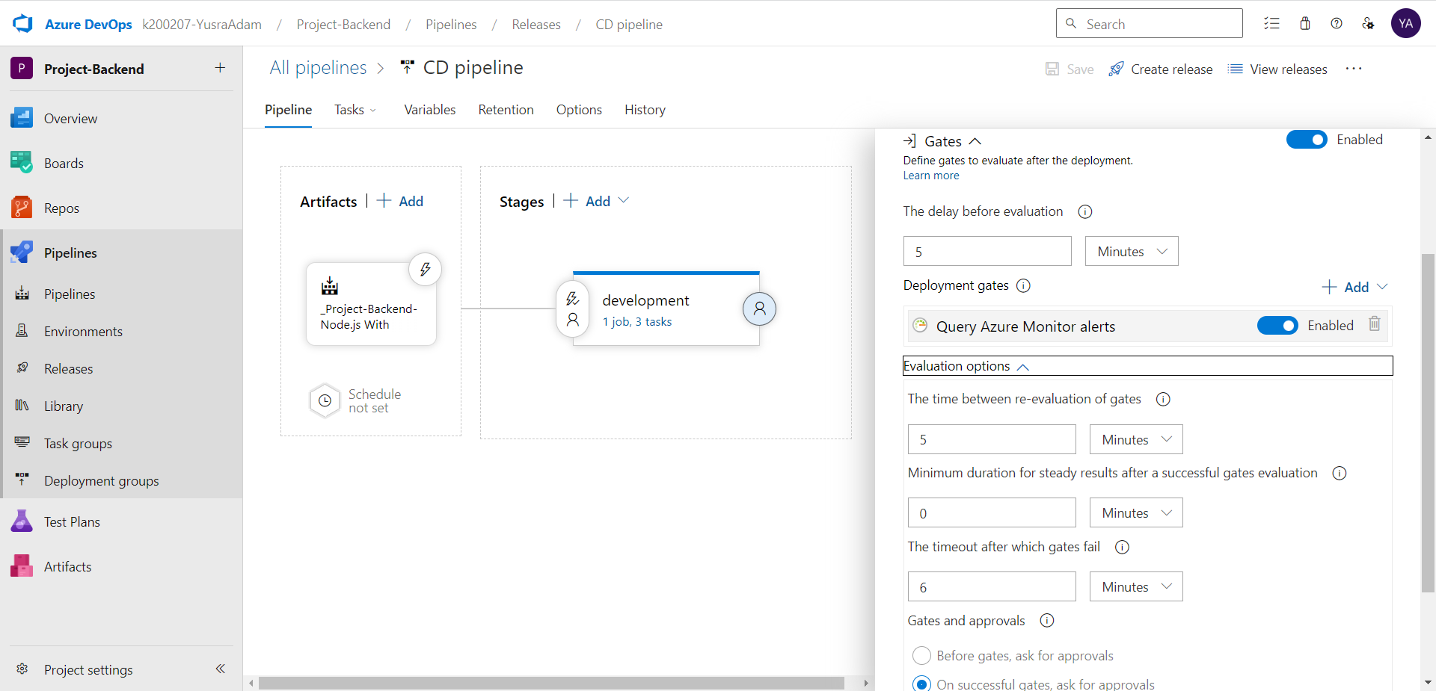
CD PIPELINE - BACKEND

Slide 33
Integration with Azure DevOps Dashboard

Slide 34
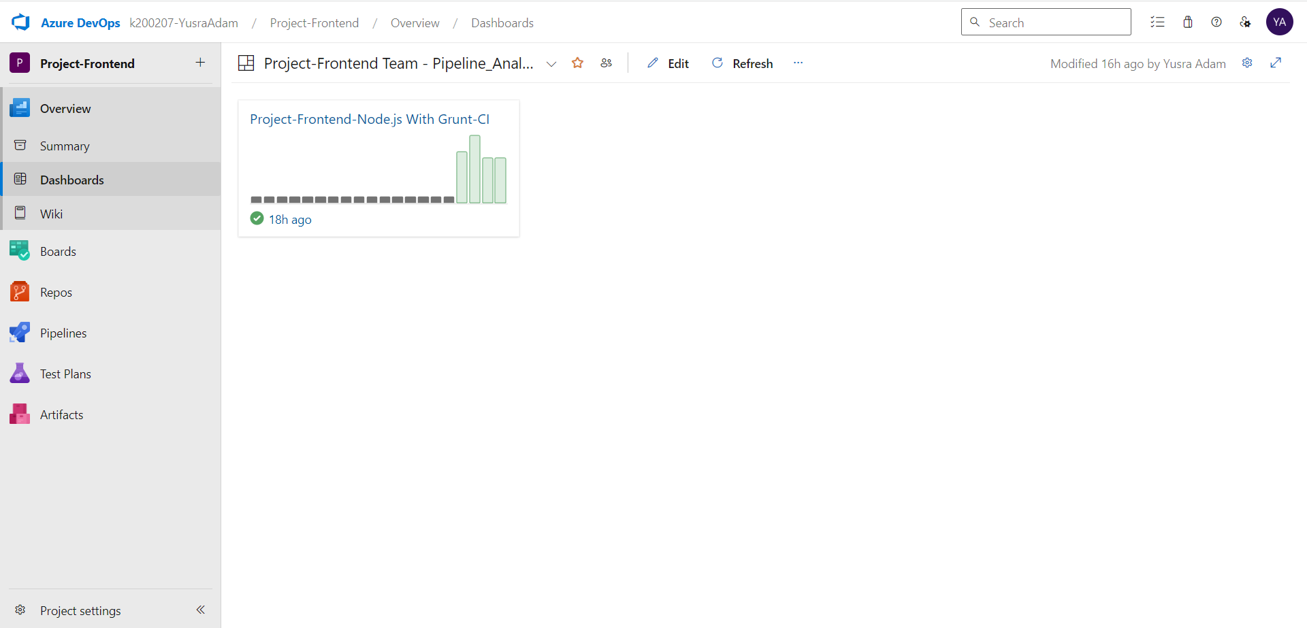
DASHBOARD - FRONTEND

Slide 35
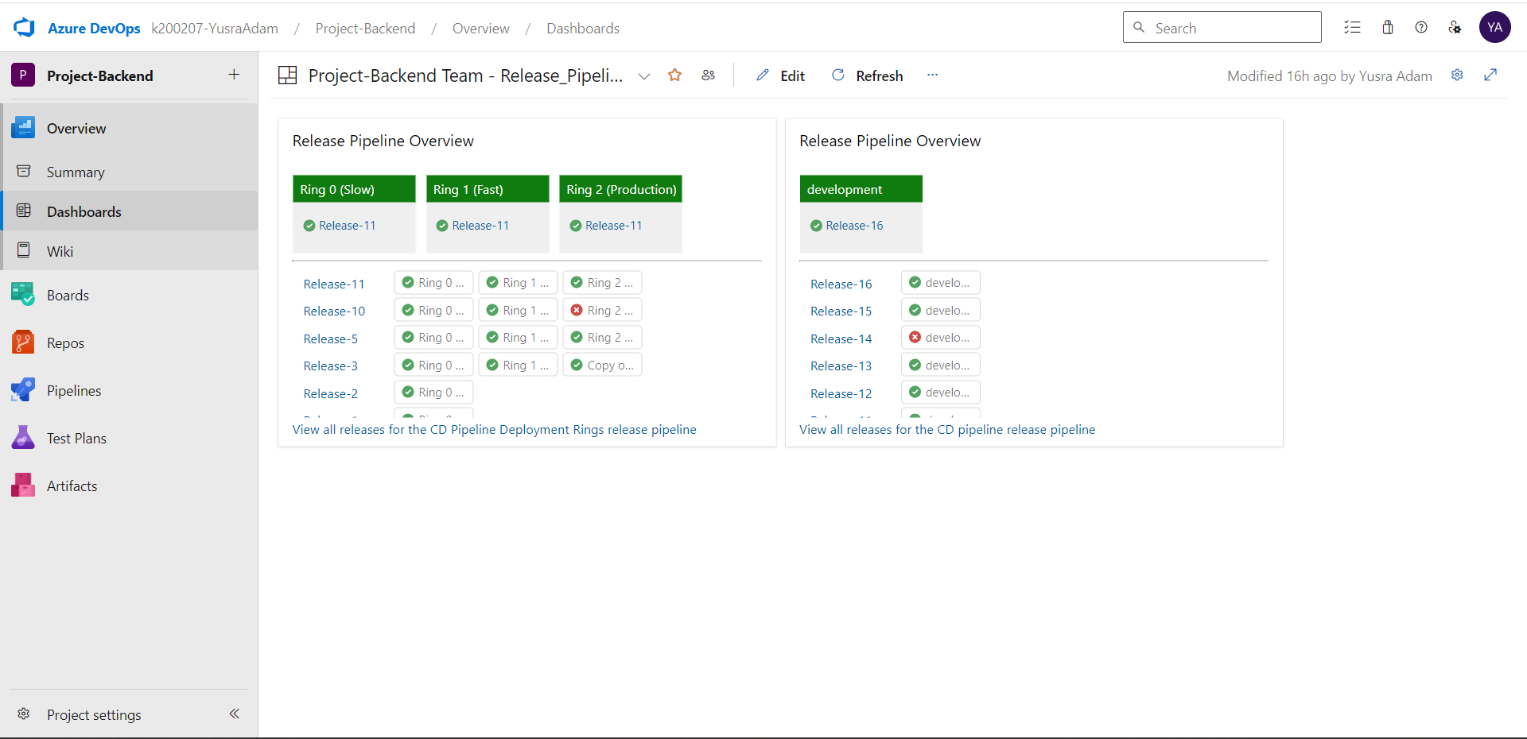
DASHBOARD - BACKEND

Slide 36
Integration with Slack

Slide 37
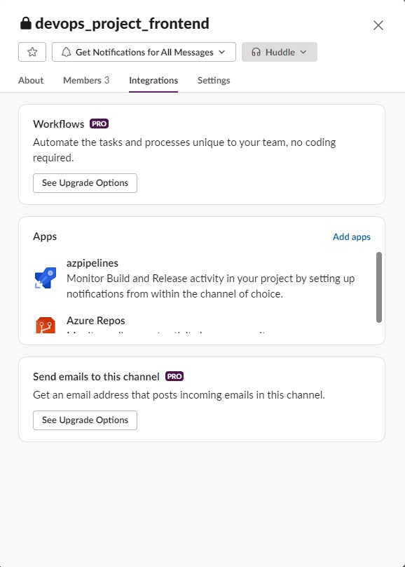
SLACK - FRONTEND

Slide 38
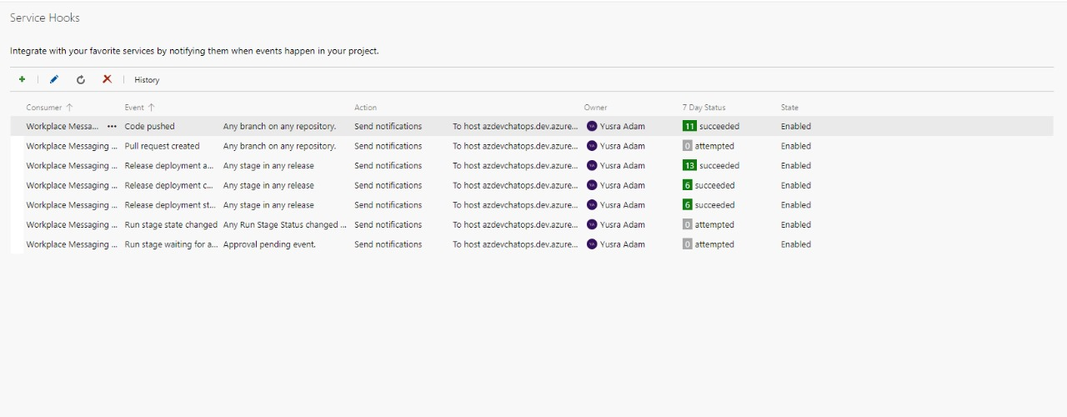

Slide 39
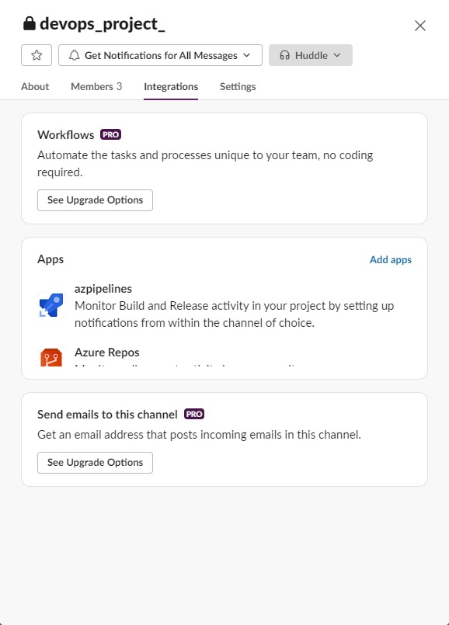
SLACK - BACKEND

Slide 40
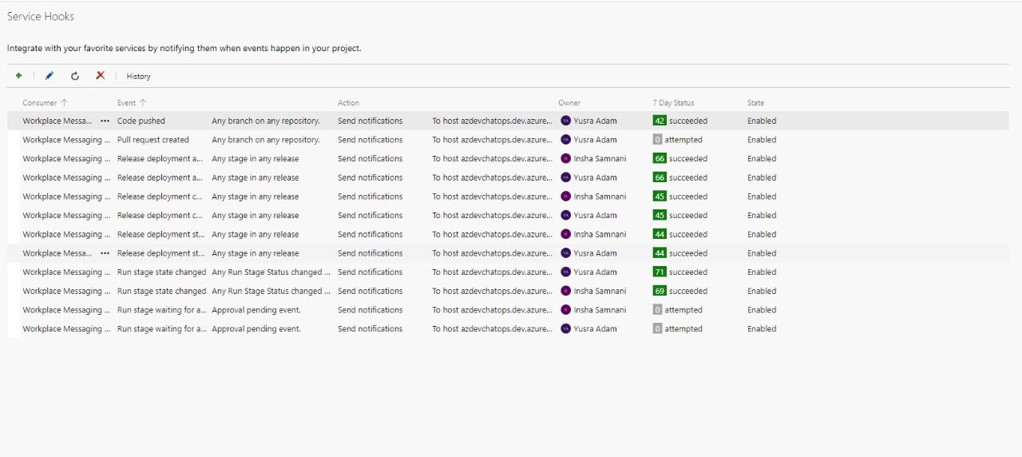

Slide 41
Wiki (Release Notes)

Slide 42
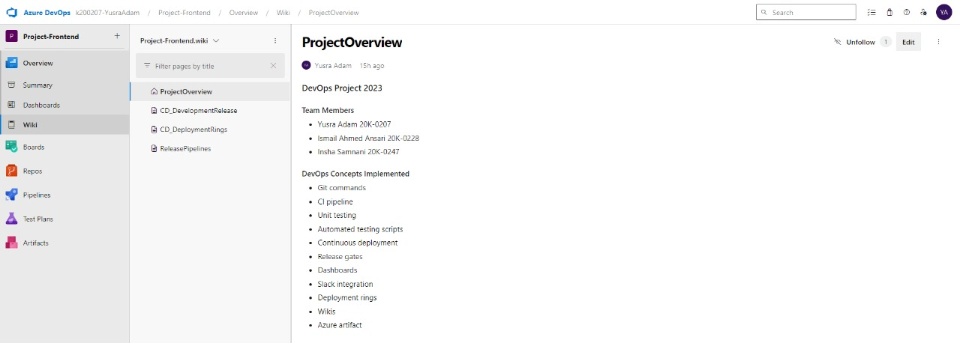
WIKI - FRONTEND

Slide 43
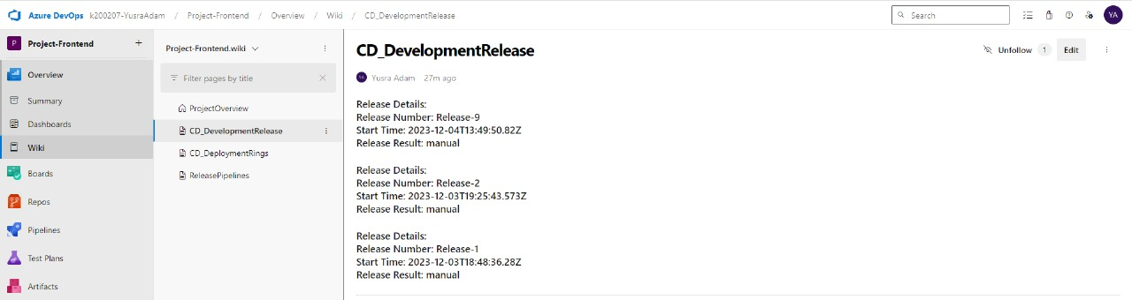
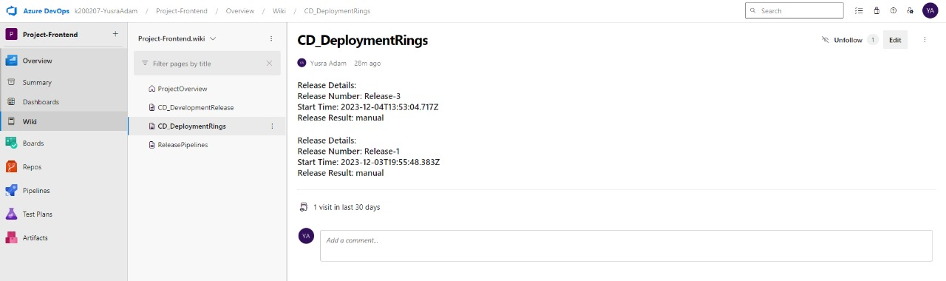

Slide 44
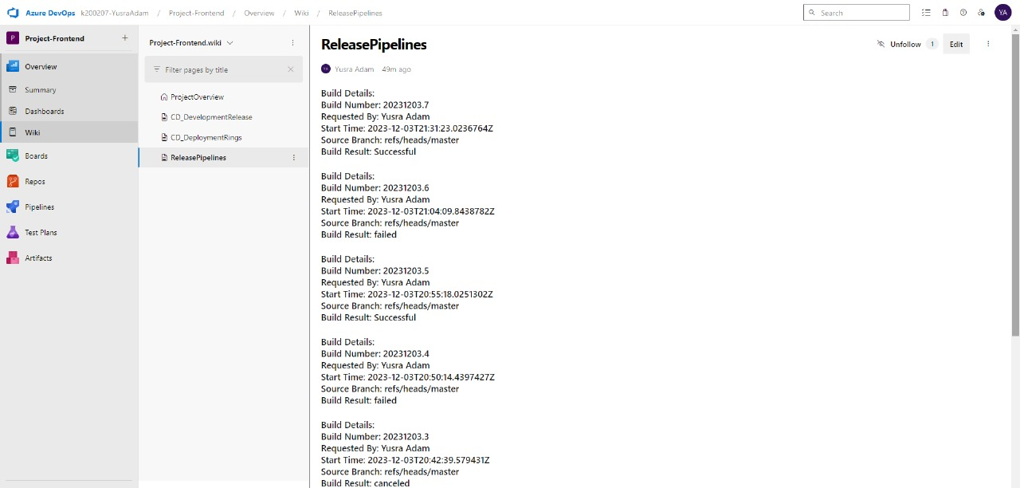

Slide 45
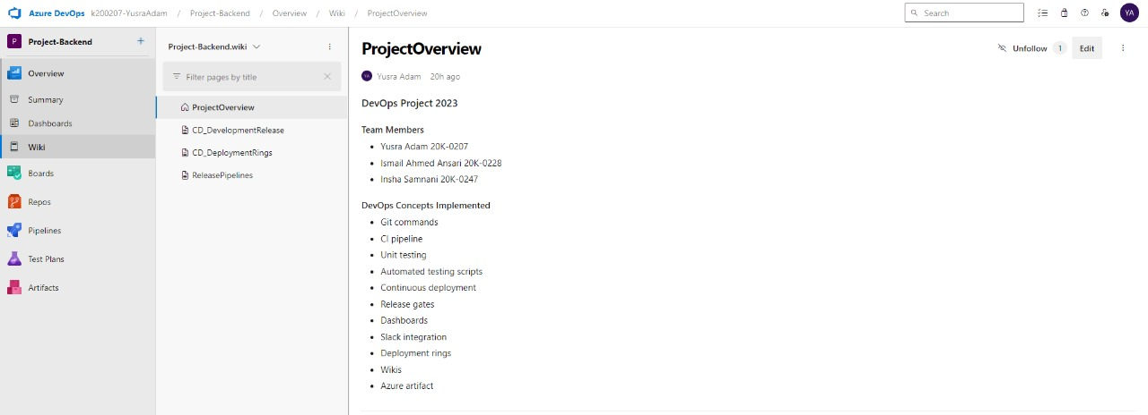
WIKI - BACKEND

Slide 46
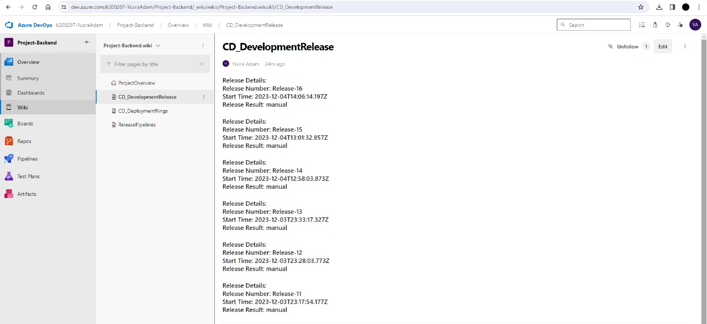

Slide 47
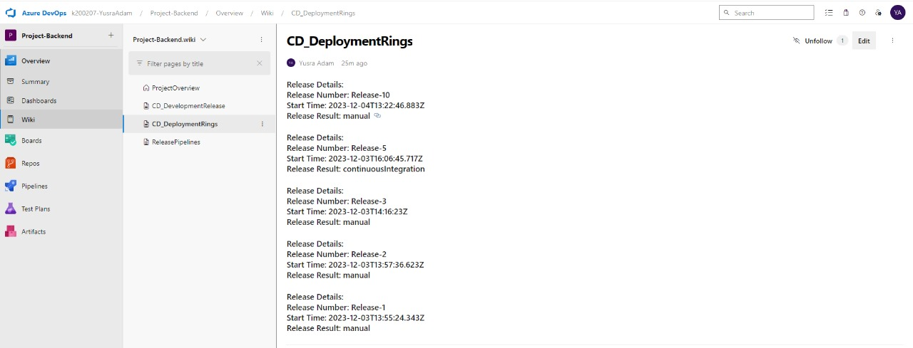

Slide 48
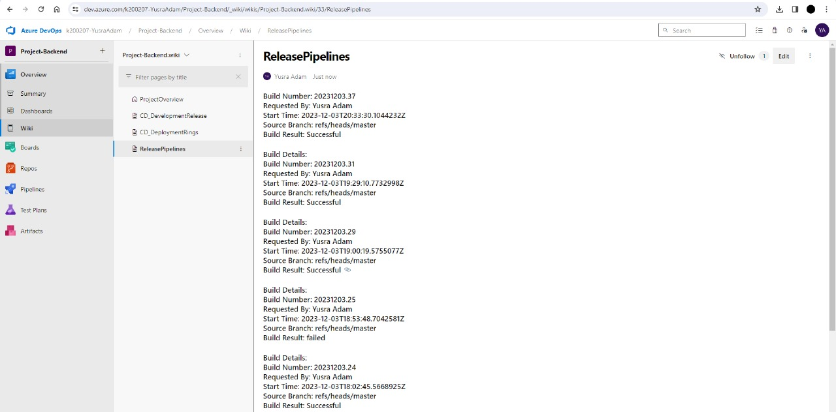

Slide 49
Azure Artifact

Slide 50
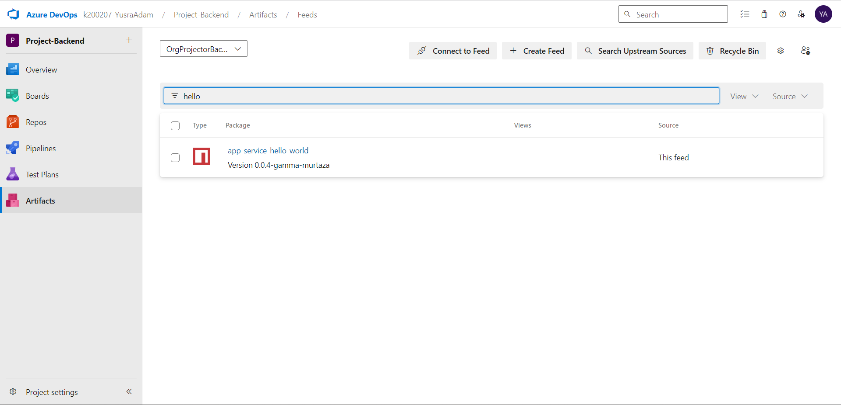
ARTIFACTS - BACKEND

Slide 51
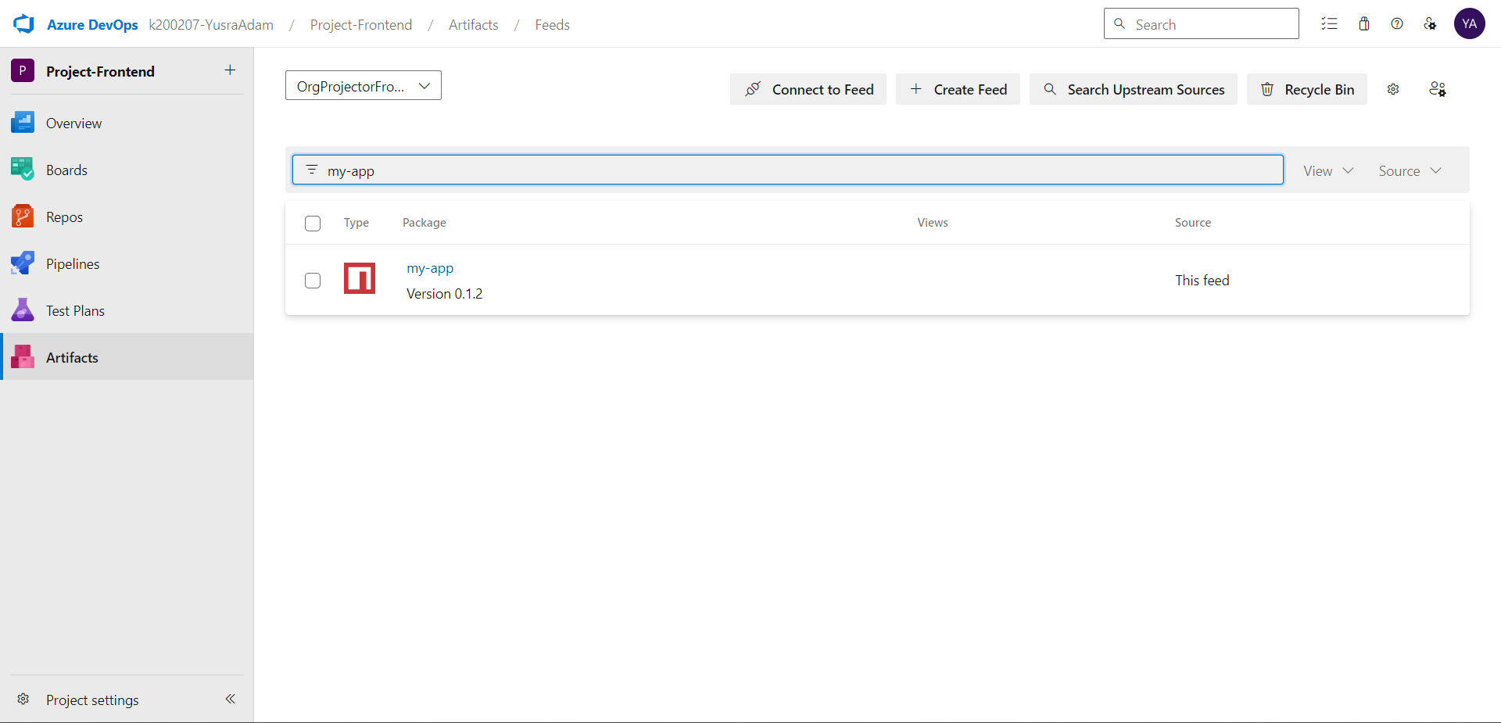
ARTIFACTS - FRONTEND

Slide 52

THANK YOU

